Slide 2
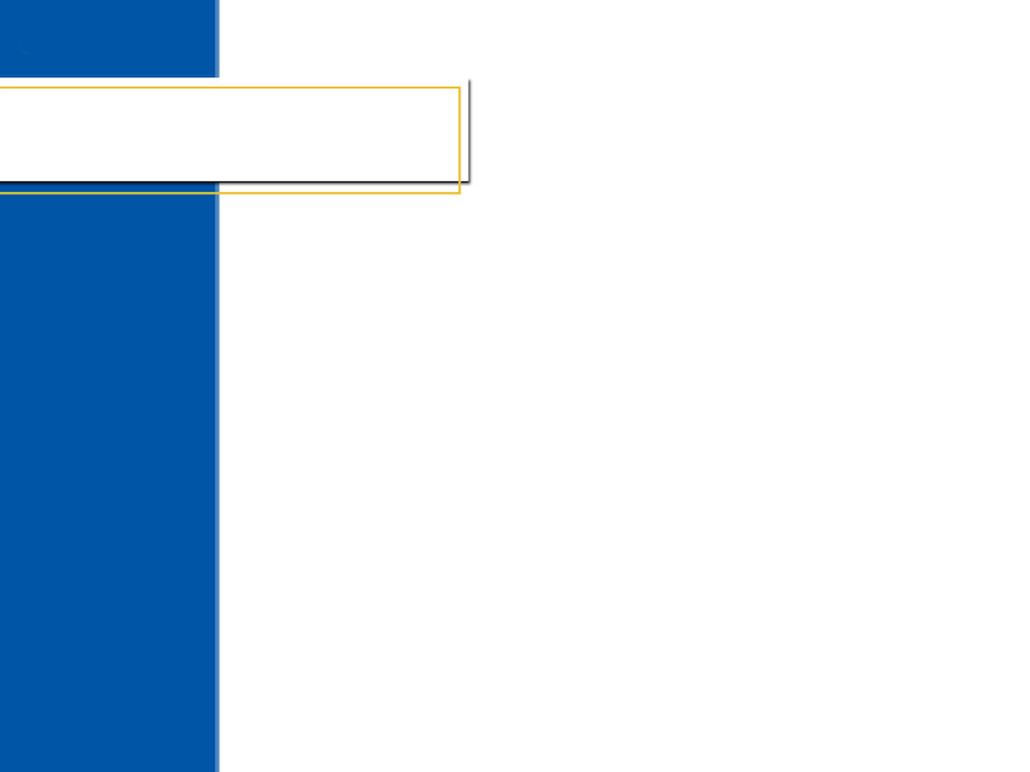

Chapter 5
Feasibility and
Business Planning
5.1
Feasibility Analysis:
Testing an Opportunity
5.2
The Business Plan

Slide 3

5.1
Discuss the importance of defining a prospective business by writing a clear and concise business concept.
Describe how a feasibility study can be used to test a concept in the marketplace.
Section 5.1 Feasibility Analysis: Testing an Opportunity

Slide 4
5.1
Business concepts need to be tested in the market.
Once a concept is judged feasible, a business plan will help the entrepreneur develop a strategy for executing the concept.
Section 5.1 Feasibility Analysis: Testing an Opportunity

Slide 5
5.1
business concept
feature
feasibility analysis
industry
target customers
competitive grid
prototype
business model
value chain
Section 5.1 Feasibility Analysis: Testing an Opportunity

Slide 6
Developing a Business Concept
Once you have a idea for a new business, define it by writing a clear and concise business concept.
business concept
a clear and concise description of a business opportunity; it contains four elements: the product or service, the customer, the benefit, and the distribution
Section 5.1 Feasibility Analysis: Testing an Opportunity

Slide 7
Developing a Business Concept
In developing a business concept, consider the features and benefits your product or service offers.
features distinctive aspects, qualities, or characteristics of a product or service
benefits things that promote or enhance the value of a product or a service to the customer
Section 5.1 Feasibility Analysis: Testing an Opportunity

Slide 8
Testing the Concept in the Market
An entrepreneur can use a feasibility analysis in order to decide if there is enough demand for a product or service.
feasibility analysis the process that tests a business concept; it allows the entrepreneur to decide whether a new business concept has potential
Section 5.1 Feasibility Analysis: Testing an Opportunity

Slide 9
Testing the Concept in the Market
A feasibility analysis can help an entrepreneur determine whether business conditions are appropriate to go forward with starting a business.
Section 5.1 Feasibility Analysis: Testing an Opportunity

Slide 10

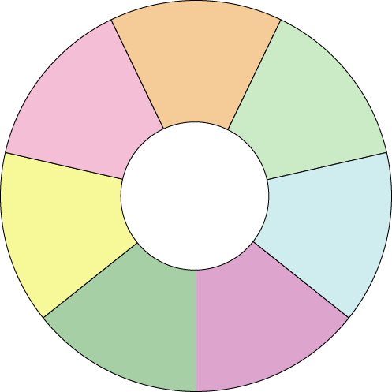
Testing the Concept in the Market
customers
product and
service
industry
Feasibility
Analysis
Questions
founding
team
value chain
start-up needs
competition
Section 5.1 Feasibility Analysis: Testing an Opportunity

Slide 11
Testing the Industry
The broadest level of feasibility analysis looks at the industry in which the business will operate.
industry a group of businesses with a common interest
Section 5.1 Feasibility Analysis: Testing an Opportunity

Slide 12
Talking to Customers
The most important part of the feasibility analysis is testing customers to measure interest and identify the target customers.
target customers people most likely to buy a business’s products and services
Section 5.1 Feasibility Analysis: Testing an Opportunity

Slide 13
Testing Product or
Service Requirements
To consider all the requirements of a product or service, create a prototype.
prototype a working model used by entrepreneurs to determine what it takes to develop their products or services
Section 5.1 Feasibility Analysis: Testing an Opportunity

Slide 14
Studying the Competition
An easy way to evaluate the competition is to create a competitive grid.
competitive grid a tool for organizing important information about a business venture’s competition
Section 5.1 Feasibility Analysis: Testing an Opportunity

Slide 15
Looking at Start-Up Resources
A strong business model is important to investors.
business model a description of how entrepreneurs plan to make money with their business concepts
Section 5.1 Feasibility Analysis: Testing an Opportunity

Slide 16
Analyzing the Value Chain
A business can create a competitive advantage by improving the value chain or its products and services.
value chain the distribution channel through which a product or service flows from the producer to the customer
The value chain includes manufacturers, distributors, and retailers.
Section 5.1 Feasibility Analysis: Testing an Opportunity

Slide 17
5.1
Discuss the importance of defining a prospective business by writing a clear and concise business concept.
A clear and concise business concept is the first step in taking an idea and building a business plan to execute the concept. The business concept helps the entrepreneur focus on the critical elements of the business: the product or service, the customer, the benefit, and the distribution.
Section 5.1 Feasibility Analysis: Testing an Opportunity

Slide 18
5.1
Describe how a feasibility study can be used to test a concept in the marketplace.
A feasibility study determines whether a new business concept has potential—whether there is enough demand for a product or service and whether business conditions are appropriate for proceeding with a business idea.
Section 5.1 Feasibility Analysis: Testing an Opportunity

Slide 19
5.2
Describe the importance of planning.
Identify and describe the components and formats of a business plan.
List two of the key mistakes that entrepreneurs make when writing a business plan.
Identify and analyze various sources of information for a business plan.
Describe how to professionally package and present a business plan.
Section 5.1 Feasibility Analysis: Testing an Opportunity

Slide 20
5.2
A business plan presents a strategy for turning a feasible business concept into a successful business.
Section 5.1 Feasibility Analysis: Testing an Opportunity

Slide 21
5.2
business plan
vision statement
mission statement
executive summary
distribution channel
direct channel
indirect channel
Small Business Administration (SBA)
trade association
Section 5.1 Feasibility Analysis: Testing an Opportunity

Slide 22
The Business Plan: Your Road Map to Entrepreneurial Success
Once you have a feasible business concept, the next step is to develop a business plan.
business plan a document that describes a new business and a strategy to launch that business
Section 5.2 The Business Plan

Slide 23
The Parts of a Business Plan
Cover Page
Market Analysis
Title Page
Competitive Analysis
Table of Contents
Marketing Plan
Executive Summary
Operations Plan
Management Plan
Organizational Plan
Company Description
Financial Plan
Product and Service Plan
Growth Plan
Mission and Vision Statements
Contingency Plan
Industry Overview
Supporting Documents
Section 5.2 The Business Plan

Slide 24
Executive Summary
The executive summary should include the most important information from each section of the business plan.
executive summary a brief recounting of the key points contained in a business plan
Section 5.2 The Business Plan

Slide 25
Executive Summary
To save time, investors and lenders rely on the executive summary to help them decide whether the business plan is worth pursuing.
Section 5.2 The Business Plan

Slide 26
Management Team Plan
The management team presents your qualifications and those of any partners.
You must describe how your management team has the capabilities to execute your business plan.
Section 5.2 The Business Plan

Slide 27
Company Description
The company description section of the business plan outlines the company’s background information and basic business concept.
Section 5.2 The Business Plan

Slide 28
Product and Service Plan
In the product and service plan section of the business plan, you present the nature of your business and the unique features of the product or service.
Section 5.2 The Business Plan

Slide 29
Executive Summary
The vision statement and mission statement state the guiding principles by which a company functions.
vision statement a declaration of the scope and purpose of a company
mission statement a declaration of the specific aspirations of a company, the major goals for which it will strive
Section 5.2 The Business Plan

Slide 30
Industry Overview
The industry overview section of the business plan presents your research into the industry, those companies providing similar, complementary, or supplementary products or services.
Section 5.2 The Business Plan

Slide 31
Industry Overview
The market analysis section of the business plan presents your research on the customer profile gathered from primary and secondary marketing research resources.
The results help you determine your overall marketing and sales strategies.
Section 5.2 The Business Plan

Slide 32
Competitive Analysis
The competitive analysis section of the business plan should demonstrate that the proposed business has a advantage over its competitors.
Section 5.2 The Business Plan

Slide 33
Marketing Plan
A marketing plan discusses how a company plans to make its customers aware of its products or services.
A marketing plan also describes the market niche, pricing, company image, marketing tactics, a media plan, and a marketing budget.
Section 5.2 The Business Plan

Slide 34
Operational Plan
The operational plan describes all the processes involving the production and delivery of the product or service.
The operational plan describes the
distribution channel
of the product or service.
distribution channel the means by which a product or service is delivered to the customer
Section 5.2 The Business Plan

Slide 35
Operational Plan
The operational plan describes the direct channel and/or indirect channel you will use to deliver your product or service.
direct channel the means of delivering a service or product directly to the customer, such as via a Web site
indirect channel the means of delivering a service or product indirectly to the customer, such as through a wholesaler
Section 5.2 The Business Plan

Slide 36
Organizational Plan
The organizational plan section of a business plan looks at the people aspects and the legal form of the business.
It also describes the roles and compensation of key management personnel and important employment policies.
Section 5.2 The Business Plan

Slide 37
Financial Plan
The financial plan presents forecasts for the future of the business.
The financial plan includes financial statements.
Section 5.2 The Business Plan

Slide 38
Growth Plan
The growth plan describes how the business will expand in the future.
Investors and lenders like to see that a business has plans to grow in a planned and controlled way.
Section 5.2 The Business Plan

Slide 39
Contingency Plan
The contingency plan section of the business plan looks at the risks to business, such as changing economic conditions and lower-than-expected sales.
It then suggests ways to minimize the risks.
Section 5.2 The Business Plan

Slide 40
Cover Page, Title Page, Table of Contents, and Supporting Documents
Every business plan should have a cover page, a title page, a table of contents, and supporting documents.
Section 5.2 The Business Plan

Slide 41
Cover Page, Title Page, Table of Contents, and Supporting Documents
To begin developing a business plan:
Make a research plan and gather data.
Set up a notebook to organize data.
Write a first draft.
Section 5.2 The Business Plan

Slide 42

Common Mistakes in Preparing Business Plans
projecting exaggerated growth levels
trying to be have expertise in all areas
claiming performance above industry averages
underestimating the need for capital
Section 5.2 The Business Plan

Slide 43
Sources of Business Plan Information
Small Business Administration (SBA)
Service Corps of Retired Executives (SCORE)
Small Business Development Centers (SBDCs)
chambers of commerce
trade associations
Section 5.2 The Business Plan

Slide 44
Small Business Administration (SBA)
To encourage entrepreneurship in our free enterprise system, the government operates the Small Business Administration (SBA).
Small Business Administration (SBA) the federal agency that provides services to small businesses and new entrepreneurs, including counseling, publications, and financial aid
Section 5.2 The Business Plan

Slide 45
Trade Associations
Trade associations supply information to entrepreneurs about start-up issues, operating costs, and analysis of trends.
trade association an organization made up of individuals and businesses in a specific industry that works to promote that industry
Section 5.2 The Business Plan

Slide 46
Packaging and Presenting the Business Plan
1
Bind the plan.
2
Use index tabs to separate sections.
3
Use an easily readable 12-point type.
4
Use bold subheadings and bullets.
5
Use the company logo at the top of every page.
6
Number each copy of the business plan and include a statement of confidentiality.
7
Include a statement on the cover page prohibiting copying of the plan.
Section 5.2 The Business Plan

Slide 47
5.2
Describe the importance of planning.
Planning helps the entrepreneur achieve goals and organize and analyze critical data. Researching costs and developing strategies about operations may reveal problems that the entrepreneur hadn’t seen previously.
Section 5.2 The Business Plan

Slide 48
5.2
Identify and describe the components and formats of a business plan.
A business plan should include these components: executive summary; management team plan; company description; product and service plan; vision and mission statements; industry overview; market analysis’ competitive analysis; marketing plan; operational plan; organizational plan; financial plan; growth plan; contingency plan; and cover page, title page, table of contents, and supporting documents. There is no right or wrong format for a business plan.
Section 5.2 The Business Plan

Slide 49
5.2
List two of the key mistakes that entrepreneurs make when writing a
business plan.
Common mistakes include: projecting exaggerated growth levels, trying to be a jack-of-all-trades, claiming performance that exceeds industry averages, and underestimating the need for capital.
Section 5.2 The Business Plan

Slide 50
5.2
Identify various sources of information
for a business plan.
Business plan information sources include: the Small Business Administration (SBA), Service Corps of Retired Executives (SCORE), Small Business Development Centers (SBDCs), chambers of commerce, and trade associations.
Section 5.2 The Business Plan

Slide 51
5.2
Describe how to professionally package and present a business plan.
Follow these guidelines to package a business plan: (1) Bind the plan.
(2) Use index tabs to separate sections. (3) Use an easily readable
12-point type. (4) Use bold subheadings and bullets to make information easy to find. (5) If there is one, use the company logo at the top of every page. (6) Number each copy of the business plan and include a Statement of Confidentiality for the reader to sign. (7) Include a statement on the cover page prohibiting copying of the plan.
Section 5.2 The Business Plan

Slide 52

The E-Business
Business Plan
A good business plan is as important for an
e-business as it is to any other business.
An E-business plan should include the following:
metrics
hardware
international markets
timeline
functionality
style
Section 5.2 The Business Plan

Slide 53
Tech Terms
functionality
the way a product or service works, such as a Web site’s features
launch
the first date on which a Web site is on the Internet
metrics
methods used to measure activity and progress, such as those on a Web site; metrics software can measure number of visitors, time of day the site is most active, and which products receive the most hits
Section 5.2 The Business Plan

Slide 54
Tech Terms
Web host
a business that provides server space and file maintenance services for Web sites controlled by businesses that do not have their own Web servers
Web server
a computer that delivers Web pages
Section 5.2 The Business Plan

Slide 55
End of

